Slide 1
Learning how to design automatically updating AI with Apache Kafka and Deeplearning4j
Jason Bell – Strata London 2018

Slide 2
Works here….
Wrote this….
Tweets here: @jasonbelldata

Slide 3
Tweet heckling is perfectly allowed.

Slide 4
The Plan

Slide 5
Design a proof of concept: automating ML model generation with Kafka and DL4J…

Slide 6
The Plan

Slide 7
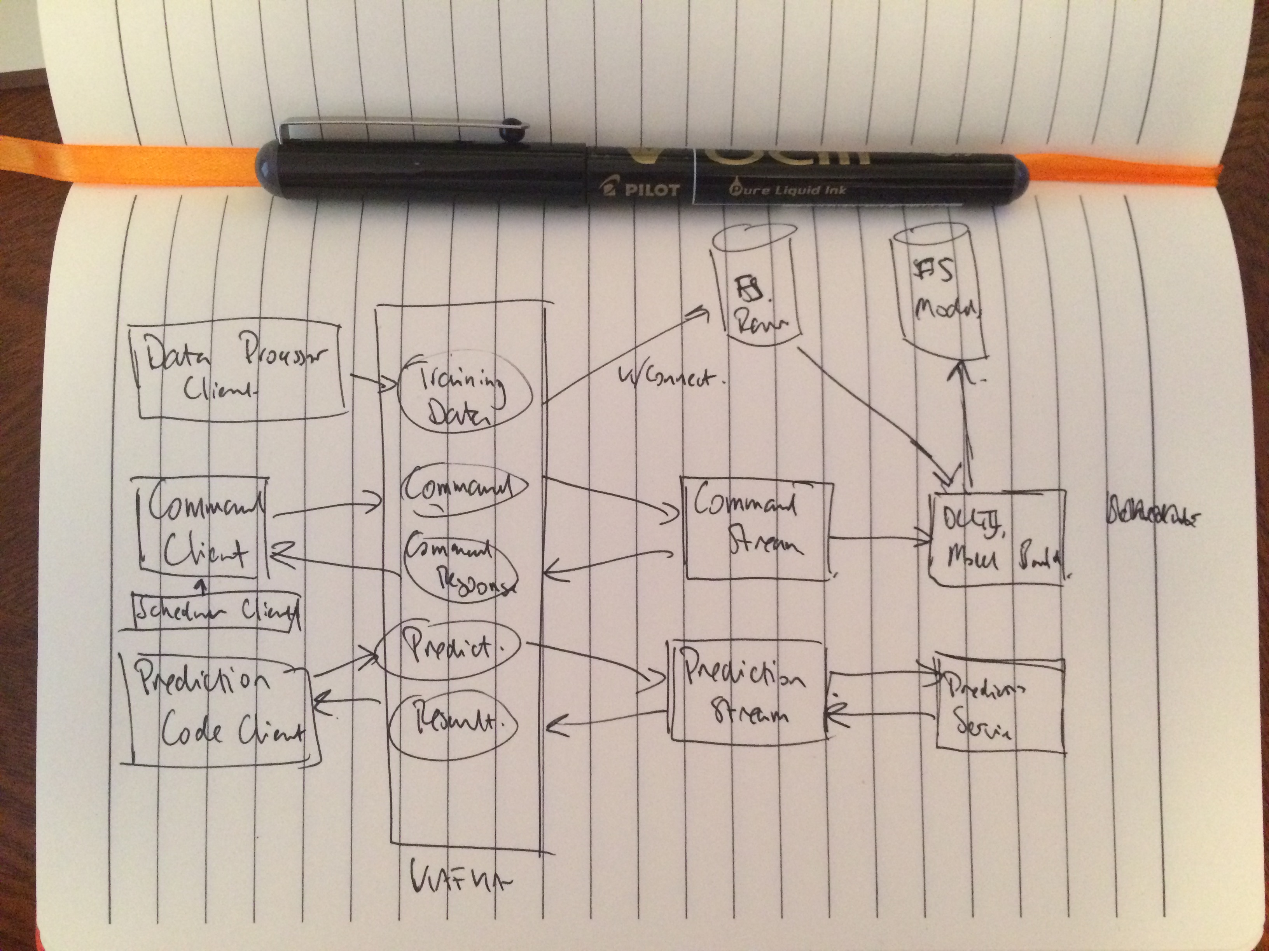
It all starts with a cup of tea, a notepad and a pen…

Slide 8
Then, a few revisions later…

Slide 9
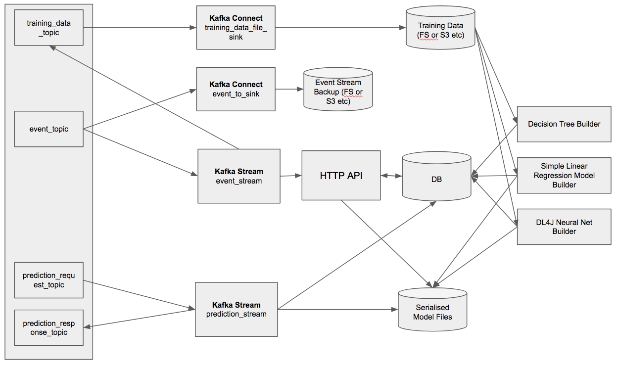

Slide 10
That’s a lot of boxes
and arrows. It can broken down to simple parts.

Slide 11
Let’s break it down a bit…..
Kafka Topics, Connect and Streams
Filesystem (or S3 etc)
A HTTP API
Model Builders
And a Database

Slide 12
Covering these main concepts
Events
Model Training
Model Prediction

Slide 13
Setting Up Kafka

Slide 15
Events and Training Data Topics
# training_data_topic - Where the raw data will be transported for training. Using Kafka Connect to push the data to a filestore.
echo "Creating topic: training_data_topic"
$KAFKA_HOME/bin/kafka-topics.sh --create --topic training_data_topic --zookeeper $ZK_CONNECT --partitions $PARTITIONS --replication-factor $REPLICATION_FACTOR
# event_stream_topic - Events are sent to the Events Kafka Streaming API application.
echo "Creating topic: event_topic"
$KAFKA_HOME/bin/kafka-topics.sh --create --topic event_topic --zookeeper $ZK_CONNECT --partitions $PARTITIONS --replication-factor $REPLICATION_FACTOR

Slide 16
Prediction Request/Response Topics
# prediction_request_topic - Sends data to the Prediction Streaming application.
echo "Creating topic: prediction_request_topic"
$KAFKA_HOME/bin/kafka-topics.sh --create --topic prediction_request_topic --zookeeper $ZK_CONNECT --partitions $PARTITIONS --replication-factor $REPLICATION_FACTOR
# prediction_response_topic - The prediction response from the original prediction_request_topic
echo "Creating topic: prediction_response_topic"
$KAFKA_HOME/bin/kafka-topics.sh --create --topic prediction_response_topic --zookeeper $ZK_CONNECT --partitions $PARTITIONS --replication-factor $REPLICATION_FACTOR

Slide 17
Persisting Event Messages

Slide 19
Everything is an event
It’s my single source of truth for training and commands.
I want to replay the product from message event zero.
I want to persist every event to the filesystem.
{“type”:”command”, “payload”:”build_mlp”}
{“type”:”command”, “payload”:”build_dtr”}
{“type”:”command”, “payload”:”build_slr”}
{“type”:”training”, “payload”:”3,4,5,7”}

Slide 20
Using Kafka Connect to Persist Events
name=dl4j-eventsw-file-sink
connector.class=FileStreamSink
tasks.max=1
file=/home/jason/testdata/events/events.json
topic=event_topic
key.converter=org.apache.kafka.connect.storage.StringConverter
value.converter=org.apache.kafka.connect.storage.StringConverter

Slide 21
Using Kafka Connect to Persist
Training Data
name=dl4j-training-data-file-sink
connector.class=FileStreamSink
tasks.max=1
file=/home/jason/testdata/connect/alldata.csv
topics=training_data_topic
key.converter=org.apache.kafka.connect.storage.StringConverter
value.converter=org.apache.kafka.connect.storage.StringConverter

Slide 22
Using Kafka Connect
bin/connect-standalone.sh config/connect-standalone.properties \
dl4j_event_to_fs_sink.properties dl4j_to_fs_sink.properties

Slide 23
Processing Event Messages

Slide 25
The Kafka Stream Event App

Slide 26
The Kafka Stream Event App
(Is it training data or a command?)
(let [partitioned-stream
(.branch
(.stream builder input-topic)
(into-array Predicate [(reify
Predicate
(test [_ _ v]
(do
(log/info "p0 " v)
(->> v
(pre-process-data)
(pred-key-type "command")))))
(reify
Predicate
(test [_ _ v]
(do
(log/info "p1 " v)
(->> v
(pre-process-data)
(pred-key-type "training")))))]))

Slide 27
The Kafka Stream Event App
(Process the two types of message)
(-> (aget partitioned-stream 0)
(.mapValues (reify ValueMapper (apply [_ v] (process-command v))))
(.print))
(-> (aget partitioned-stream 1)
(.mapValues (reify ValueMapper (apply [_ v] (process-training v))))
(.to training-topic-name)))

Slide 28
The Kafka Stream Event App
;; Process any commands, basically fire them at the HTTP API.
(defn process-command [data-in]
(let [jsonm (pre-process-data data-in)]
(slurp (str api-endpoint (:payload jsonm)))))
;; Extract the CSV training data and return it.
(defn process-training [data-in]
(let [jsonm (pre-process-data data-in)]
(.getBytes (:payload jsonm))))

Slide 29
Models

Slide 31
Model use three frameworks.
Neural Networks in DeepLearning4J
Decision Trees in Weka
Linear Regression with Apache Commons Math

Slide 32
Model use three frameworks.
Neural Networks in DeepLearning4J
Decision Trees in Weka
Linear Regression with Apache Commons Math
A 200% Talk Bonus!

Slide 33
Basic Flow of the Model Builds for Neural Networks and Decision Trees

Slide 34
Basic Flow of the Model Builds for Simple Linear Regression

Slide 35
The HTTP API receives commands from the Event Stream App
(GET "/build_mlp" []
:return {:result String}
:summary "Builds the neural network model"
(ok {:result (mlp/run-model-build)}))
(def script-path "/home/jason/work/strata-2018-kafka-dl4j-clojure/projects/dl4j.mlp/scripts/runmlp.sh")
(defn run-model-build []
(sh script-path)
"Neural Network built.")

Slide 36
The endpoint calls the function to run the script.
#!/bin/bash
JAR_PATH=/home/jason/work/strata-2018-kafka-dl4j-clojure/projects/dl4j.mlp/out/artifacts/Strata2018Java_jar/Strata2018Java.jar
java -cp .:..:$JAR_PATH eu.jasebell.strata2018.mlp.ANNBuilder

Slide 37
Neural Net Code in DL4J
MultiLayerConfiguration conf = new NeuralNetConfiguration.Builder()
.seed(seed)
.iterations(iterations)
.activation(Activation.TANH)
.weightInit(WeightInit.XAVIER)
.learningRate(0.1)
.regularization(true).l2(1e-4)
.list()
.layer(0, new DenseLayer.Builder().nIn(numInputs).nOut(hiddenNodes).build())
.layer(1, new DenseLayer.Builder().nIn(hiddenNodes).nOut(hiddenNodes).build())
.layer(2, new DenseLayer.Builder().nIn(hiddenNodes).nOut(hiddenNodes).build())
.layer(3, new OutputLayer.Builder(LossFunctions.LossFunction.NEGATIVELOGLIKELIHOOD)
.activation(Activation.SOFTMAX)
.nIn(hiddenNodes).nOut(outputNum).build())
.backprop(true).pretrain(false)
.build();
//run the model
MultiLayerNetwork model = new MultiLayerNetwork(conf);
model.init();
model.setListeners(new ScoreIterationListener(100));
model.fit(trainingData);

Slide 38
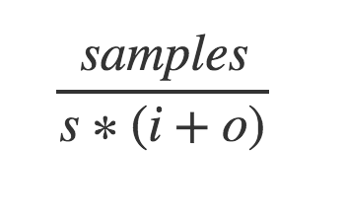
How many hidden nodes?

Slide 39
Decision Trees in Weka
J48 cls = new J48();
try {
Instances inst = new Instances(new BufferedReader(new FileReader("/home/jason/testdata/alldata.arff")));
inst.setClassIndex(inst.numAttributes() - 1);
try {
long start = System.currentTimeMillis();
cls.buildClassifier(inst);
Evaluation evaluation = new Evaluation(inst);
Random rand = new Random(1);
int folds = 10;
evaluation.crossValidateModel(cls, inst, folds, rand);
long stop = System.currentTimeMillis();
DBTools.writeResultsToDB(uuid, -1, (stop - start), evaluation.pctCorrect()/100, evaluation.toSummaryString(), "dtr");
} catch (Exception e) {
e.printStackTrace();
}

Slide 40
Simple Linear Regression with Apache Commons Math
private SimpleRegression getLinearRegressionModel(List<String> lines) {
SimpleRegression sr = new SimpleRegression();
for(String s : lines) {
String[] ssplit = s.split(",");
double x = Double.parseDouble(ssplit[0]);
double y = Double.parseDouble(ssplit[1]);
sr.addData(x,y);
}
return sr;
}

Slide 41
The database is updated with info about the model build.

Slide 42
With Linear Regression the slope and intercept are written to the DB.

Slide 43
Making Predictions

Slide 45
Two methods to make a prediction. 1. Direct calls to the HTTP API

Slide 46
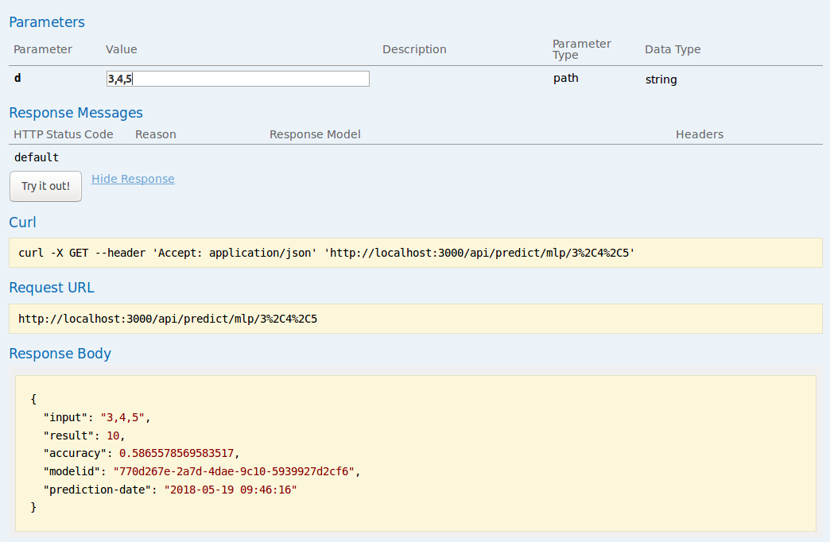
Two methods to make a prediction. 1. Direct calls to the HTTP API

Slide 47
2. Send a message to the prediction_request_topic

Slide 48
2. Send a message to the prediction_request_topic
{“model”:”mlp”,”payload”:”3,4,5”}

Slide 49
Predictions within Streaming Apps (NN in DL4J).
(defn make-prediction [model input]
(let [input-vector (Nd4j/create (split-input input))
prediction (.output model input-vector)]
(.iamax (Nd4j/getBlasWrapper) prediction)))
(defn predict-mlp [x]
(let [model-info (get-most-accurate-model)
model (load-mlp-model (:uuid model-info))
prediction (make-prediction model x)]
{:input x
:result prediction
:accuracy (:model_accuracy model-info)
:modelid (:uuid model-info)
:prediction-date (f/unparse (f/formatters :mysql) (t/now))}))

Slide 50
Predictions within Streaming Apps (DT in Weka).
(defn classify-instance [model instance]
(do
(.setClassIndex instance(- (.numAttributes instance) 1))
(.classifyInstance model (.instance instance 0))))
(defn predict-decision-tree [x]
(let [instance (create-instance x)
model-info (get-most-accurate-model)
model (load-model (:uuid model-info))
result (classify-instance model instance)]
{:input x
:result result
:accuracy (:model_accuracy model-info)
:modelid (:uuid model)
:prediction-date (f/unparse (f/formatters :mysql) (t/now))}))

Slide 51
Predictions within Streaming Apps (SLR).
(defn calc-linear [slope intercept x]
(+ intercept (* x slope)))
(defn predict-simple-linear [x]
(let [model (first (load-simple-linear))
input (convert-input-to-integer x)
result (calc-linear (:slope model)
(:intercept model)
input)]
{:input input
:result result
:accuracy (:rsq model)
:modelid (:uuid model)
:prediction-date (f/unparse (f/formatters :mysql) (t/now))}))

Slide 52
Retraining

Slide 53
Retraining the Models
I’m using Cron to rerun the models daily.
Sending a message to the event_topic keeps the event stream order preserved.
Remember training results are in the database.

Slide 54
Improvements?

Slide 55
A few…

Slide 56
Improving the DL4J Model Builds.
Modify the Event Streaming app to map through the scaling factor to create ten new models.
Container the model build: start -> complete -> terminate.
Let developers develop Keras models and let DL4J handle the predictions?

Slide 57
Predictions
Model loading is slow, I could persist them in RAM.
Consider how to update newer more accurate models.
Predict against all models.

Slide 58
Random Samples of Training Data
Use Hadoop to create random samples.
Store the results (part-00000 etc)
Run the training on the results.
Link the training bundle to the result set (use same uuid etc)
Large data volumes would kill Weka model builds.

Slide 59
Random Samples of Training Data
public static class RandomSampleMapper extends Mapper<Object, Text, NullWritable, Text> {
private Random rands = new Random();
private Double percentage;
@Override
protected void setup(Context context) throws IOException, InterruptedException {
String strPercentage = context.getConfiguration().get("percentage");
percentage = Double.parseDouble(strPercentage) / 100.0;
}
@Override
public void map(Object key, Text value, Context context)
throws IOException, InterruptedException {
if (rands.nextDouble() < percentage) {
context.write(NullWritable.get(), value);
}
}
}

Slide 60
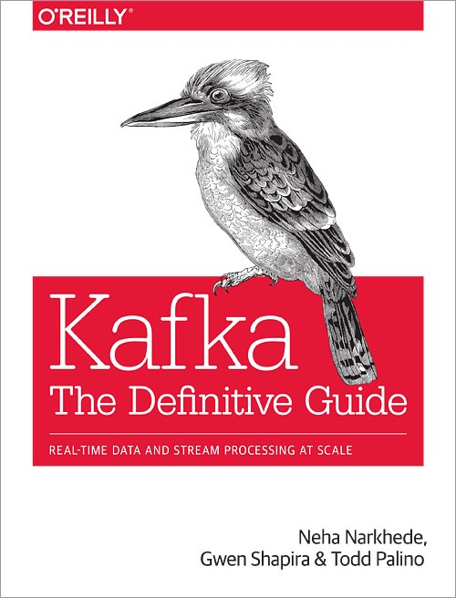
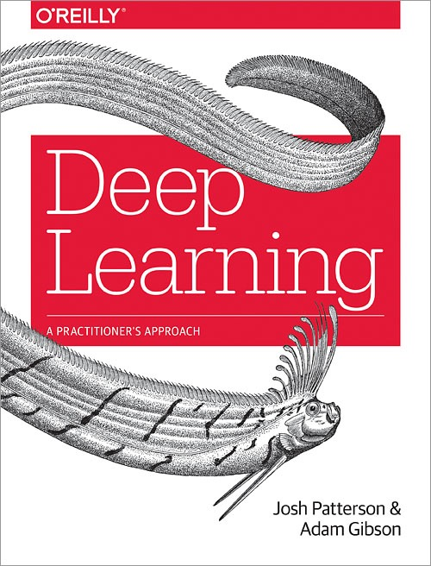
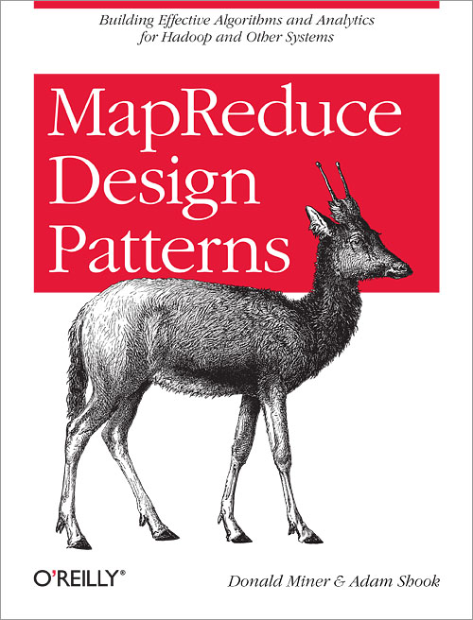
Some useful reading.

Slide 61
https://github.com/jasebell/strata-london-2018
An extended Q&A will be available in London City Airport departures….. :)

Slide 62
Thank you.
http://www.mastodonc.com
Twitter: @jasonbelldata

